Slide 1

Dojo Introduction
Don’t Re-Invent the Wheel

Slide 2

Dojo Introduction
Lesson Content:
    What is dojo and who is behind it?
    Dojo widgets
    Why use Dojo?
    Why not use Dojo?
    Comparison to other toolkits

Slide 3


What is Dojo?
Dojo is:
  A toolkit written in JavaScript.
  It is Open Source.
  It is a tool for creating dynamic web user interfaces easily

Slide 4
What is Dojo?
Dojo allows you to easily build and add capabilities into web pages and other environment that supports JavaScript.
Dojo offers widgets, utilities, higher IO (AJAX) abstraction and many other features.
It is BSD or AFL licensed.
It also means “a school or practice hall where karate, judo, or other martial arts are taught.”

Slide 5

Who is behind it?
An open source development community.
A Not-For-Profit foundation.
Foundation members such as IBM and Sun Microsystems provide financial support.
Many other commercial entities as members.

Slide 6
Dojo Widgets
Beside libraries which can be used by the developer, Dojo also contains a part called “Widget Toolkit”.
Widget is a user interface object that has a layout and some properties.
In Dojo, widgets are HTML+CSS bound by JavaScript.
Dojo has lots of useful widgets, e.g., Tabs, sorting table, dialogs.

Slide 7
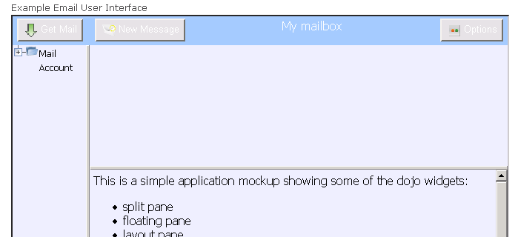
Dojo Widgets
email

Slide 8
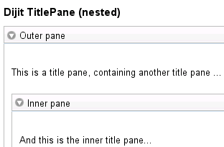
Dojo Widgets - Dijit
<div dojoType="dijit.TitlePane" title="Outer Pane">
This is a title pane containing another title pane
<div dojoType="dijit.TitlePane" title="Inner Pane">
And this is the inner title pane...
</div>
</div>
Dijit at a glance

Slide 9
Why use Dojo? (technical)‏
Dojo has many packages of JavaScript code, to take care of all of the infrastructure work needed to build an online JavaScript application.
It encapsulates cross browser changes.
It has easy access to the DOM.
It makes the XMLHttpRequest work in any of the browsers, and provides a simple API.
It is more XHTML compliant than you

Slide 10
Why use Dojo? (technical - cont)‏
Dojo provides many widgets out of the box.
Dojo provides a framework for writing new widgets.
Many effects such as drag and drop, fade in and out.

Slide 11
Why use Dojo? (architectural)‏
Can run not only in browsers but other host environments as well. Dojo support is possible even on the server-side.
On complex Ajax applications, Dojo helps writing professional, quality, JavaScript applications.
It is comprehensive with “pick and choose”

Slide 12
Why use Dojo? (arch - cont)‏
It does not force any particular server side technology.
Industry support.
Prepares you for other industry standards such as Open Ajax.

Slide 13

Why not use Dojo?
It’s very heavy on the browser client side.
As many other Open Source projects, it has bugs.
It has a learning curve.
It forces you into it's way of
Doing things.
Some widgets are still immature

Slide 14
Other toolkits
There are many other toolkits to ease the creation of AJAX applications.
Examples are: YUI, DWR, GWT, JQuery and more.
They differ in forcing a particular server side technology and whether they intend on being “everything and the kitchen sink”.
YUI is the closest to Dojo in this sense.

